Slide 1
CUSTOMER APPROVAL PROCESS MODELING
FOR A FINTECH COMPANY

Slide 2
EXECUTIVE SUMMARY
Data is taken from a fintech company that provide lending for student
A start up Company in Fintech Peer to Peer Lending want reduce the approval time in order to Increase efficiency and reduce manpower utilization for analyzing customer approval
Current Business Issue is high manpower utilization to analyze most of the borrower application and application process takes 1-3 days
A machine learning based on K-means clustering is developed to cluster the result of approval: approved or rejected based on some criteria such as Type of Product, Ecommerce, Price, Down payment, Installment and Time Period of installment
Data is taken based on thousand historian data using K-means method
Using Machine Learning, Process of approval can be reduced from 1-3 days to < 30 Mins

Slide 3
BUSINESS ISSUE
With current practice, the company use software that has basic requirement for the student to apply the loan, and most of the application process must check by analyst for final approval
This makes the application takes process 1-3 days
Also, there is high manpower utilization to analyze the application
Using K-Means Clustering, we want to see if there is some pattern or cluster of a condition that an applicant can have highly probably of get approved so we can reduce the manpower workload.

Slide 4
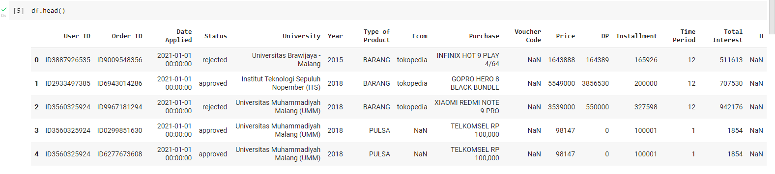
DATA INFORMATION
User ID
of applicant
Order ID
of applicant
Status of application
Year of entering university
E-commerce where the user is used to buy
Voucher used by user in ecommerce
Down
Payment
Time period of Installment
Date when user apply for lending
University of the user
Product of the fintech : Cicilan Barang, Cicilan Uang Kuliah and Cicilan Pulsa
Purchase of the user in e-commerce
Price of product that bought by user
Remaining Installment from fintech
Total interest that should be paid by user from the Installment

Slide 5
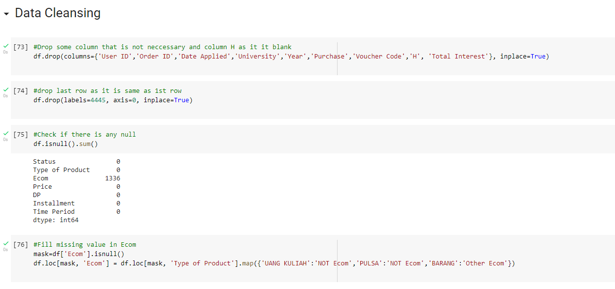
DATA CLEANSING
Dropping some column that is not necessary for machine learning Total interest is dropped because it is the calculation from other column, H column as it is blank, and the last row is just copy of all column title
Check if there is any missing value
The missing value is replaced based on condition from type of product. If the type of product is “Uang Kuliah and Pulsa” then missing value in Ecom will be filled by “NOT Ecom”

Slide 6
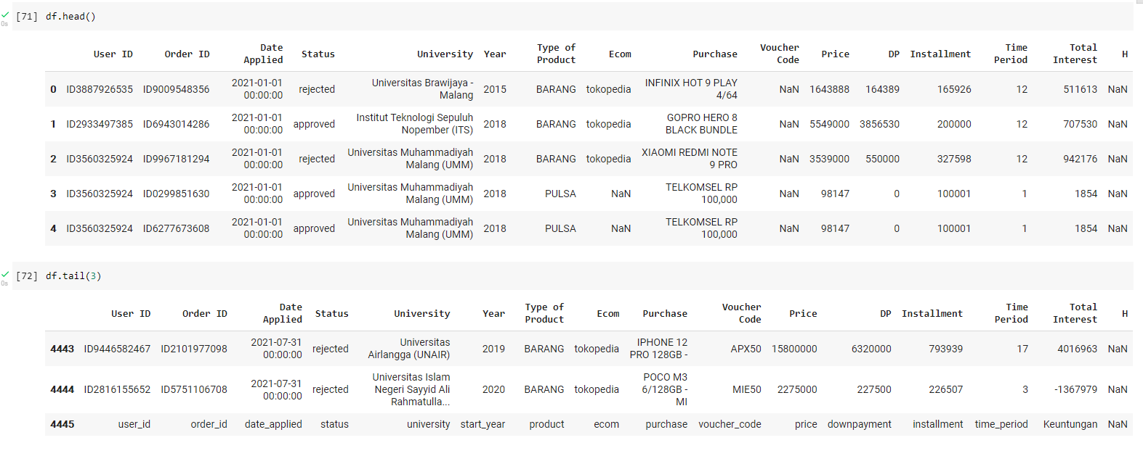
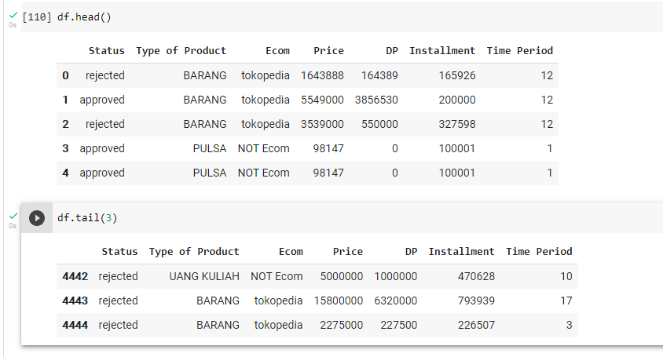
DATA CLEANSING
BEFORE
AFTER
After initial data cleansing, only total 7 column is used for K-means clustering.

Slide 7
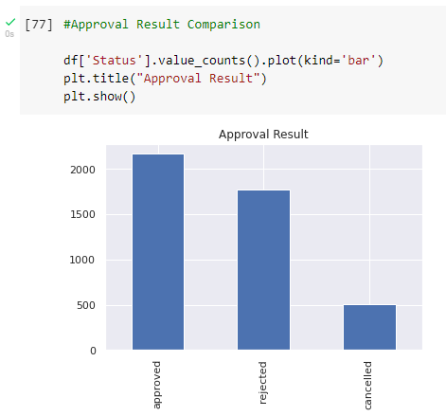
EXPLORATORY DATA ANALYSIS
“Cancelled” data will not be used as it means the application process is canceled by user before get result from analyst
The approved and rejected data seems to have good distribution

Slide 8
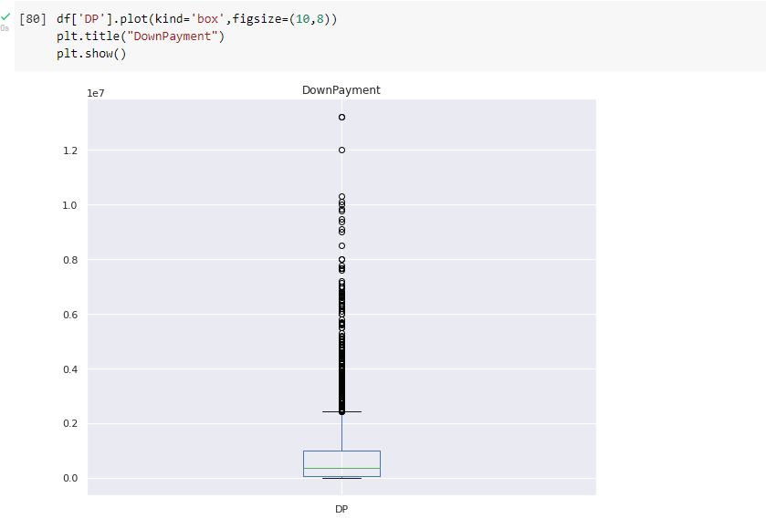
EXPLORATORY DATA ANALYSIS
Down payment distribution is also looks good as some user used 0 DP and there are few user using up to 1,2 M Down payment

Slide 9
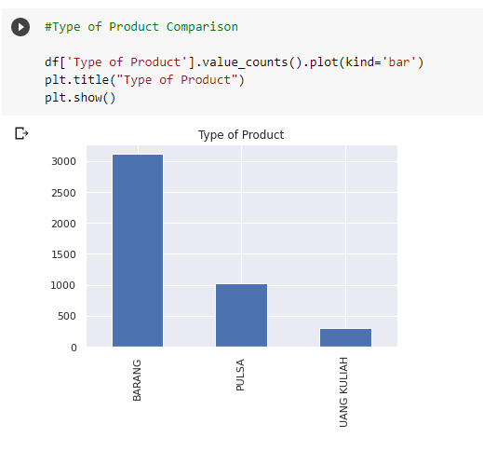
EXPLORATORY DATA ANALYSIS
Most of the user is using the loan to purchase product in
e-commerce

Slide 10
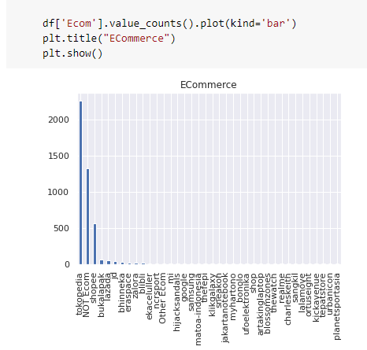
EXPLORATORY DATA ANALYSIS
There are lot of e-commerce that only been use few times compare to Tokopedia, Shopee, Not from ecommerce.
Most of this ecommerce will be dropped in step “further data cleansing”

Slide 11
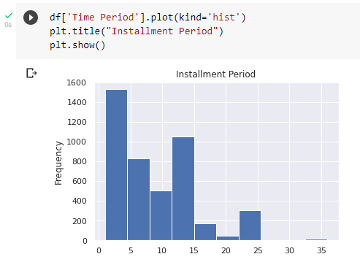
EXPLORATORY DATA ANALYSIS
Installment Period is from 1-24 Months

Slide 12
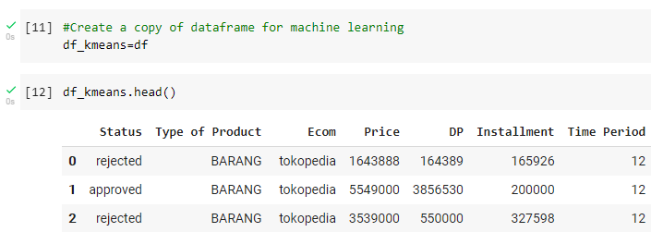
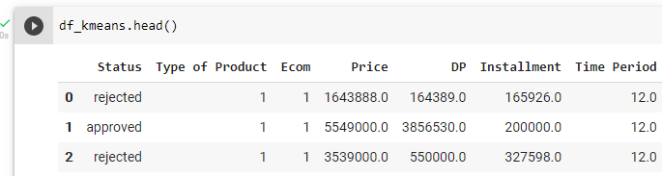
DATA PREPROCESSING
BEFORE
AFTER

Slide 13
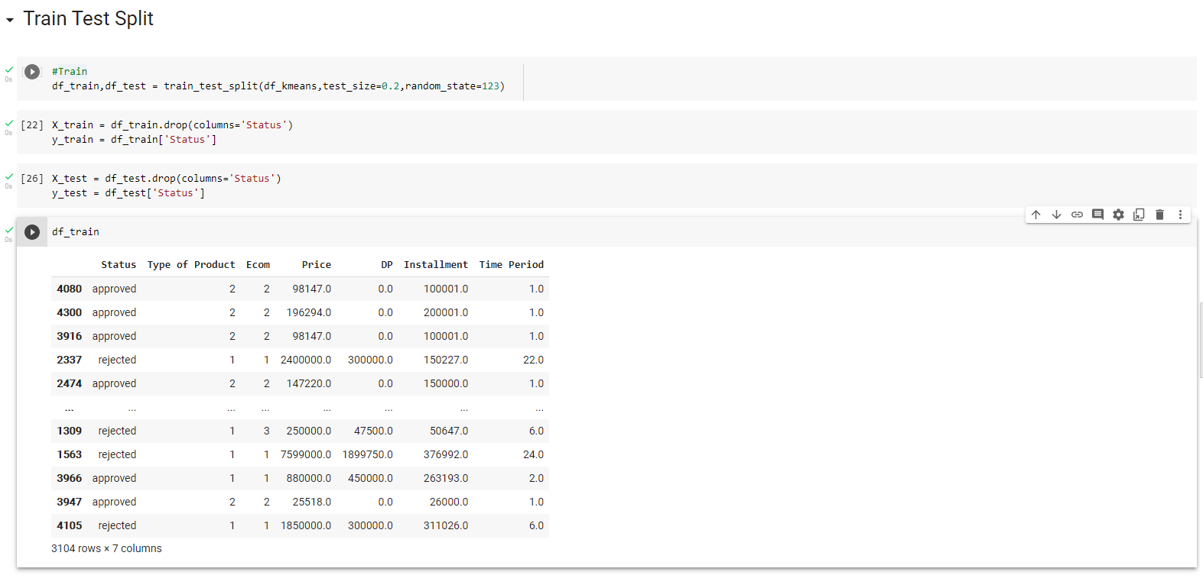
DATA PREPROCESSING

Slide 14
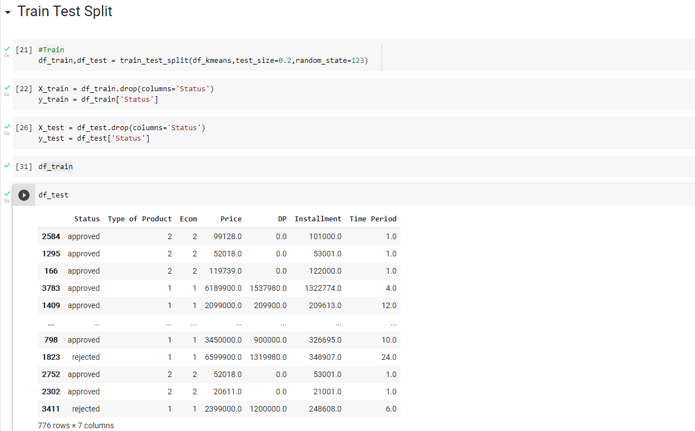
DATA PREPROCESSING

Slide 15
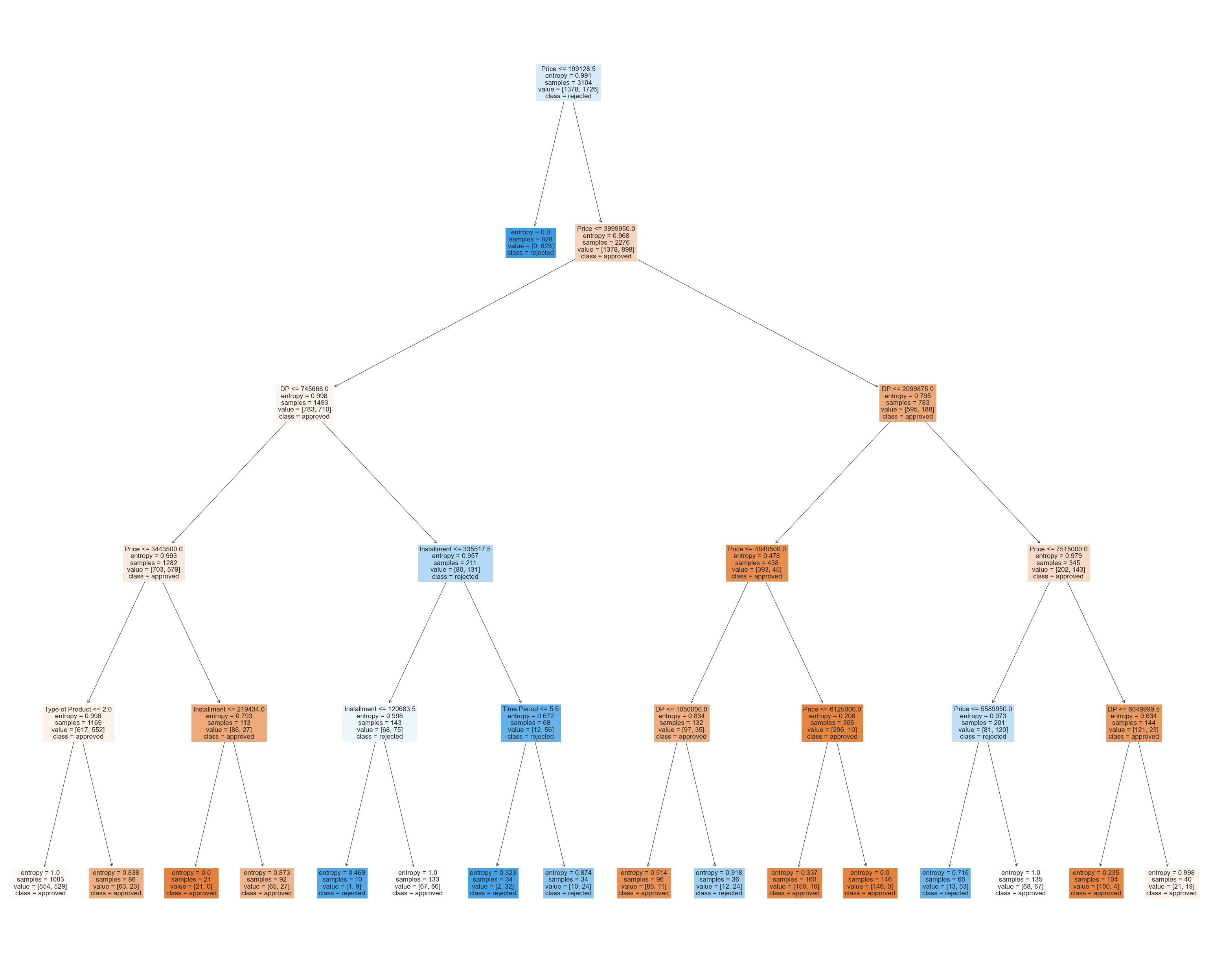
MODEL RESULT

Slide 16
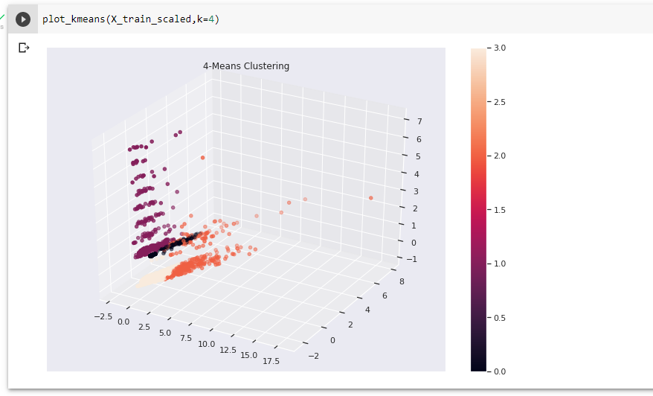
MODEL RESULT

Slide 17
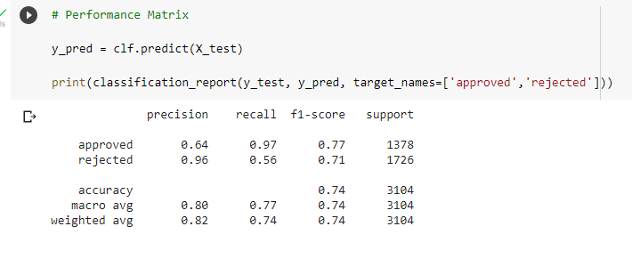
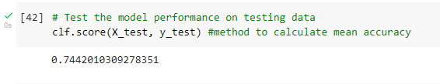
MODEL PERFORMANCE
For Approval using the model, it is best to use “Recall”
Accuracy of the model = 0,74

Slide 18
RECCOMENDATION
For new application for loan, it is better to use “recall” from model prediction
The Accuracy of model prediction should be improved to minimize the risk of the applicant that supposed to be rejected but get approved (false positive) and the risk of false negative that can lead to loosing potential profit.

Slide 19
The link to google colab
Machine Learning Project using Decision Tree.ipynb - Colaboratory (google.com)
The File that I’m Using is HERE

